Slide 1
A S L
ASL Letter Recognition Using a CNN
Classifying static hand-sign images into English letters A–Z with a convolutional neural network built from scratch.
Presented by: Salma sameh, Saif Amr Mohamed, Youssef alaa el dine, Yassin Ahmed Shendy, Omar Mahmoud Waked
[Artificial intelligence] • [9/9/2026]

Slide 2
The Project
What we built, and why
Goal
?
The Problem
Given one static ASL hand-sign image, predict the corresponding English letter (A–Z).
American Sign Language is a primary means of communication for many Deaf and hard-of-hearing people, but most hearing people cannot read it. Automatic recognition of ASL hand signs is a step toward closing that communication gap and toward accessibility tools that translate signs into text in real time.
Objectives
✓
Build an image classification pipeline from a raw Kaggle dataset to a trained model
✓
Design and train a CNN from scratch — no pretrained backbone
✓
Restrict the task to the 26 letter classes (excluding space / delete / nothing)
✓
Evaluate performance per-letter and identify where confusion occurs
✓
Package a simple “upload an image, get a letter” demo
ASL Letter Recognition — CNN Project
3

Slide 3
Dataset & Pipeline
From raw images to a predicted letter
29 → 26
Kaggle
80 / 20
classes used (letters only; space / delete / nothing removed)
“ASL Alphabet” dataset (grassknoted/asl-alphabet)
training / validation split
Pipeline
ASL
Image
Resize
128×128
Normalize
0–1
CNN
26
Probabilities
Predicted
Letter
No horizontal flip is used during augmentation — mirroring a hand sign can change its meaning, so it would create ambiguous labels.
ASL Letter Recognition — CNN Project
4

Slide 4
Technical Details — Data Preparation
Getting images ready for the network
Data Augmentation (training only)
Preprocessing Settings
Image size
128 × 128 px
↻
Random Rotation
±8% of a full turn, to tolerate slight hand tilt
Batch size
32
Validation split
20%
⤢
Random Zoom
up to 10% in/out, to tolerate distance from camera
Label mode
Categorical (one-hot, 26 classes)
Pixel scaling
Rescaled 0–255 → 0–1
◐
Random Contrast
up to 10%, to tolerate lighting differences
Random seed
42 (reproducible split)
Deliberately not used: horizontal flip — it can turn one letter's hand shape into a different, ambiguous label.
ASL Letter Recognition — CNN Project
5

Slide 5
Technical Details — Model Architecture
A convolutional neural network built from scratch
Input — 128×128×3
Training Configuration
Conv2D 32 + ReLU — 3×3 kernel
Optimizer
Adam, learning rate 0.001
MaxPooling 2×2
Loss function
Categorical cross-entropy
Conv2D 64 + ReLU — 3×3 kernel
MaxPooling 2×2
Metric
Accuracy
Conv2D 128 + ReLU — 3×3 kernel
Max epochs
15
MaxPooling 2×2
Early stopping
Monitors val_loss, patience 3
Flatten
LR schedule
Reduce on plateau (×0.5, patience 2)
Dense 128 + ReLU
Dropout 0.40
Why this design?
Dense 26 + Softmax — output layer
Three conv blocks of increasing depth (32→64→128) let the network build up from edges to finger positions to full hand shapes before classifying.
ASL Letter Recognition — CNN Project
6

Slide 6
Why a CNN?
Matching the model to an image classification problem
Why a CNN fits this task
✕
Why not simpler models?
▦
Local pattern detection
Convolution filters pick up on edges, finger contours, and knuckle lines wherever they appear in the image.
Fully-connected (dense) network
Flattening a 128×128×3 image gives 49,152 inputs — the first dense layer alone would need millions of weights, and it ignores where pixels sit relative to each other.
⇄
Parameter sharing
The same small filter slides across the whole image, so the network needs far fewer weights than a dense layer on raw pixels.
Classical CV (e.g. HOG + SVM)
◰
Built-in translation tolerance
Needs hand-engineered features and struggles to generalize across lighting, skin tones, and hand positions in the dataset.
Max-pooling lets the model recognize a hand shape even if the hand isn't perfectly centered in frame.
▲
Hierarchical features
Stacked conv blocks (32→64→128) build from simple edges up to complete finger and hand configurations.
ASL Letter Recognition — CNN Project
7

Slide 7
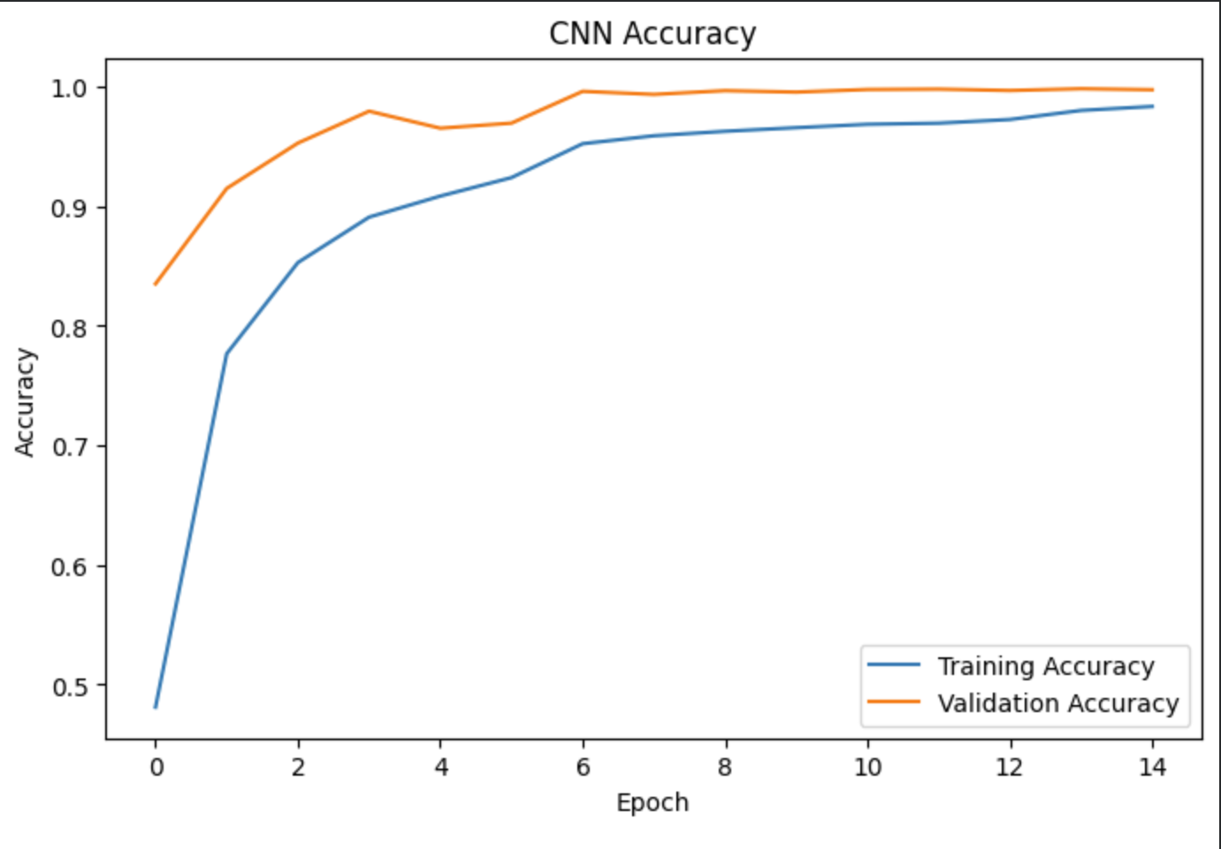
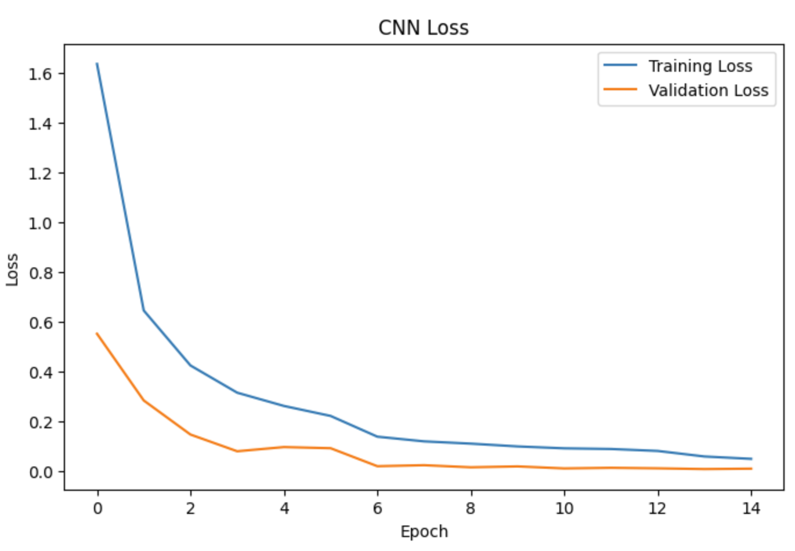
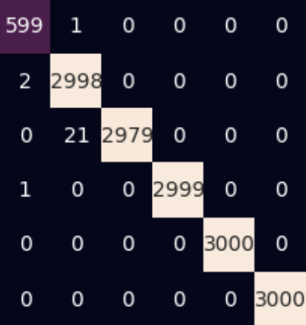
Evaluation
How well does the model classify letters?
99.78%
0.0092
11/15
Validation accuracy
Validation loss
Best epoch (early stopping)
Accuracy & Loss Curves
Confusion Matrix
[Insert training vs. validation accuracy/loss plot]
[Insert confusion matrix heatmap — note which letters are most confused]
ASL Letter Recognition — CNN Project
8

Slide 8
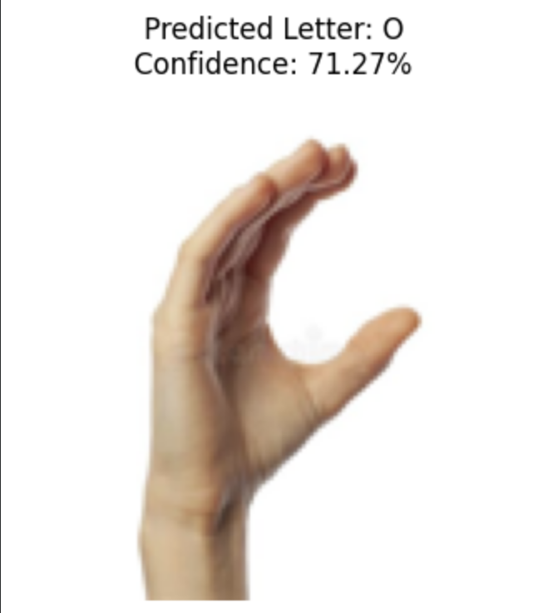
Try It Yourself
Live demo: image in, letter out
1
Upload an image
A clear, single-hand ASL sign photo
[Insert screenshot of uploaded ASL image]
2
Model preprocesses it
Resized to 128×128 and passed to the CNN
3
Get a prediction
Predicted letter + confidence percentage shown instantly
Example
Input: photo of a “O" hand sign → Output: Predicted Letter: O (confidence 71.27 %)
Predicted Letter: O
Confidence: 71.27%
ASL Letter Recognition — CNN Project
9

Slide 9
Conclusion & Future Work
Conclusion
Future Work
✓
Built a from-scratch CNN that classifies static ASL hand signs into 26 letters
→
Extend to video input to capture motion signs (J, Z) and continuous fingerspelling
✓
Full pipeline: raw Kaggle images → preprocessing → training → evaluation → single-image demo
→
Deploy the saved .keras model behind a web app or mobile camera app
✓
Reached 99.78 % validation accuracy (see Evaluation)
→
Broaden the dataset with more hands, skin tones, backgrounds, and lighting conditions
✓
Main limitation: J and Z involve motion and can't be fully captured by a single static image
→
Explore transfer learning (e.g. MobileNet) to compare against the from-scratch CNN
→
Extend beyond letters to common words and short phrases
Thank you

